Slide 1
ALT
A Pessimistic Car Recommender

Slide 2
Car Price Skyrocketing, Wallet Shrinking...
Many buyers (like myself) can no longer afford their favorite cars.
ALT (short for "alternative") aims to help potential buyers efficiently find alternative options by recommending cars similar to the dream car they've always wanted yet could no longer get.
Countless hours and even days could be saved.
2019 | 2020 | 2021 | 2022

Slide 3

Link to App
http://msia423-1925432727.us-east-1.elb.amazonaws.com/

Slide 4




Data & Storage
Car advertisement data. Each row is a listing with the specifications and price of the listed car.
Aggregated the raw data by 4 key attributes and summarized the rest by taking means or modes.
Clustered the cars using K-means and stored the labeled data on RDS.
Flask App uses the labeled data from RDS to make predictions.
User Input: (Maker, Model, Year, Body Type)
app.py
Aggregated Data (Local)
Labeled Data (RDS)
Maker | Model | Year | Body Type | …
Audi | Q5 | 2016 | SUV | …
Infiniti | Q50 | 2016 | Saloon | …
… | … | … | … | …
Maker | Model | Year | Body Type | … | Cluster
Audi | Q5 | 2016 | SUV | … | 1
Infiniti | Q50 | 2016 | Saloon | … | 2
… | … | … | … | … | …
K-means

Slide 5
Modeling
User Input: (maker, model, year, bodytype)
Maker | Model | Year | Body Type | … | Cluster
… | … | … | … | … | …
maker | model | year | bodytype | … | K
… | … | … | … | … | …
Clustering algorithm: K-means
Features: engine size, seat number, door number, gearbox
Number of clusters: 50
Recommendation strategy
Recommend cars in the same cluster as the input
Offline model
Labels saved to RDS before deployment
Success Criterions
Model Metric: Silhouette > 0.5
Business Metric: Day 1 Retention Rate > 0.1%
match
Labeled Data (RDS)
Offline
Model
Cluster Assignment of Input Car
filter
Maker | Model | Year | Body Type | … | Cluster
… | … | … | … | … | K
… | … | … | … | … | K
… | … | … | … | … | K
Recommendations

Slide 6
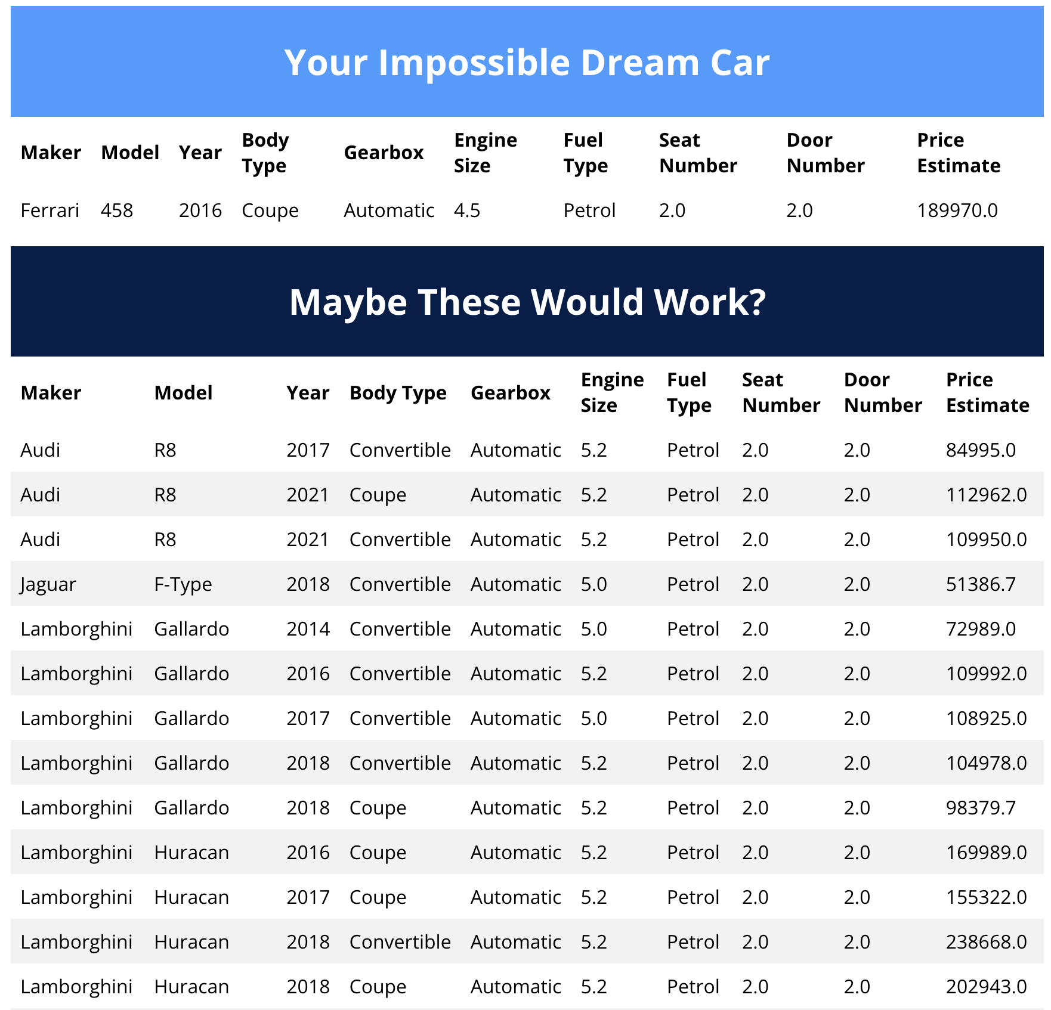
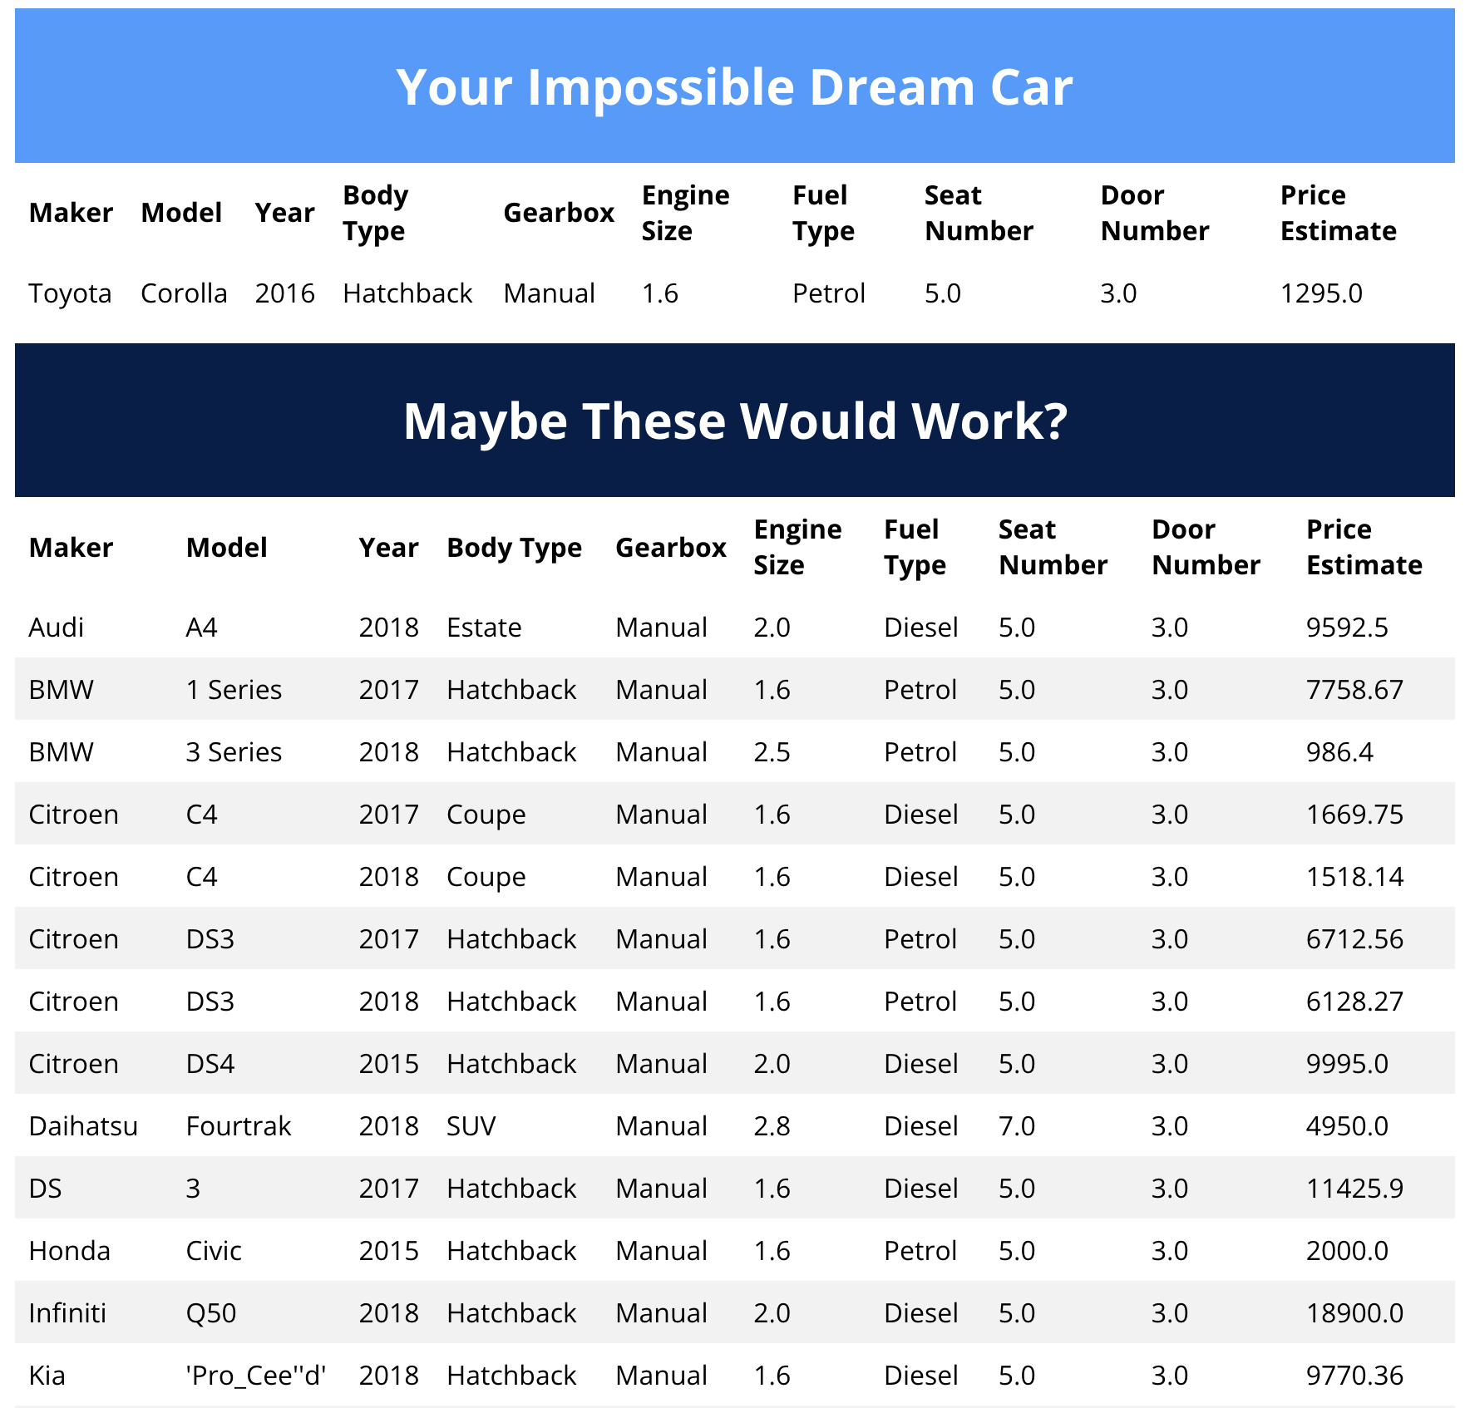
Observation - Cars in the Same Cluster Have Similar Prices Price was not used to create clusters

Slide 7
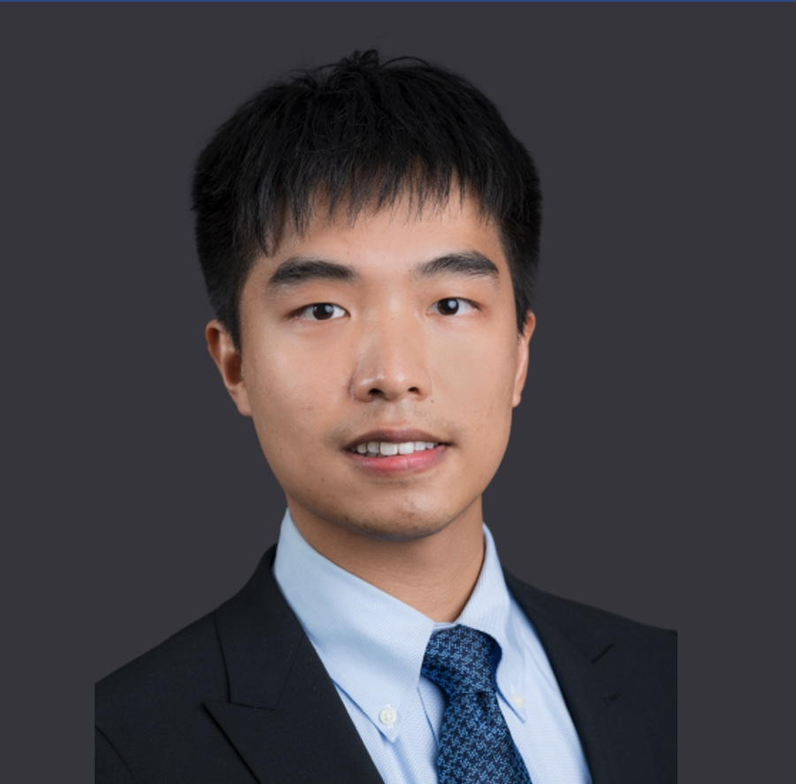
Thank you!
Haoyang (Bill) Cai
Email: : HaoyangCai2022@u.northwestern.edu
LinkedIn: https://www.linkedin.com/in/haoyang-cai/

